Slide 1

ETHOS
PATHOS
LOGOS
Argumentative Rhetoric and Persuasive Appeals

Slide 2
What We Should Know
1. What does it mean to argue persuasively?
2. What are the foundations of a sound argument?
3. What are the specific persuasive appeals used in Aristotle’s Rhetorical Triangle, and how do they work?
4. What do these appeals look like?

Slide 3
Persuasive Writing
The goal of argumentative/persuasive writing is to persuade your audience that your ideas are valid, or more valid than an opposing argument.
The Greek philosopher Aristotle divided the means of persuasion, appeals, into three categories--ethos, pathos, logos.

Slide 4
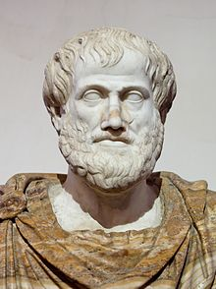
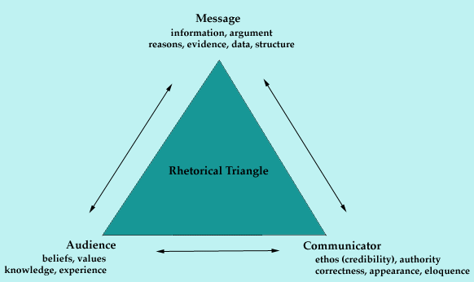
Aristotle – The Man Who Argued

Slide 5
Aristotle taught there are 3 main strategies used in presenting a formal argument:
Logos (Gr. “word”) – logical appeal
Ethos (Gr. “character”) – trustworthy/credible appeal
Pathos (Gr. “suffering”, “experience”) – emotional appeal

Slide 6
The Route of Rhetoric
Author’s Purpose
Logos
Ethos
Pathos
The core of the rhetorical chart is purpose—What does the author/speaker
cartoonist/filmmaker/advertiser want the reader/listener/viewer to
Feel? Think? Do?

Slide 7
Ethos – Ethical Appeals the source's credibility, the speaker's/author's authority
How well an author/speaker presents him/herself
Questions for considering a writer’s ethos:
  Does he or she seem knowledgeable? Reasonable? Trustworthy?
  Does he or she treat their opponents with fairness and respect or do they take cheap shots?
  Does he or she try and establish common ground with the reader/audience?

Slide 8
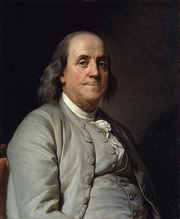
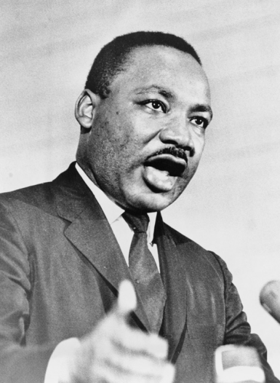
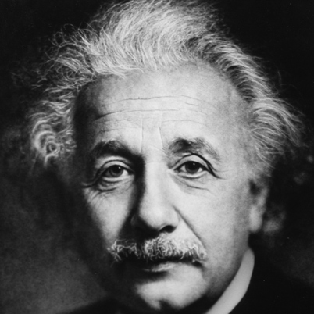
Ethos – Credibility
Appeals to the conscience, ethics, morals, standards, values, and principles.
Author or speaker tries to convince you he is of good character.
Qualified to make his claims.
Cites relevant authorities.
Quotes others accurately and fairly.

Slide 9
Examples of Ethos
Kevin Durant can market Nike’s products as beneficial to his athletic performance because he is known as an exceptional athlete.
When Albert Einstein was in talks regarding nuclear warfare during World War II, his opinion was respected because of his scientific study and expertise.

Slide 10
Pathos – Emotional Appeals the emotional or motivational appeals; vivid language, emotional language and numerous sensory details.
How well the author taps into the audiences emotions
Questions for considering a writer’s pathos:
Does the topic matter to the audience?
Does the writer include anecdotes?
Does the writer appeal to your emotions, memories, fears, etc.?
Is the emotional appeal effective or overwhelming?
Is the writing overloaded with facts and figures?

Slide 11




Pathos – Emotional Appeal
Appeals to the heart,
Emotions,
Sympathy,
Passions,
Sentimentality,
Uses imagery, figurative language,
Carefully constructed sentences.

Slide 12
Examples of Pathos
“Mom, there is clear evidence that cell phones save lives in emergency situations. Don’t you want me to be safe?” – We tend to employ pathos when we really want something from a family member.
The ASPCA released a number of commercials displaying abused animals in order to increase numbers of members and donations, playing on a populace that wanted to see cute puppies, rather than abused, wounded puppies. (No thanks to Sarah McLachlan! Really? Really…)

Slide 13
Logos: Logical Appeal the logic used to support a claim; can also be the facts and statistics used to help support the argument.
How well the author uses text and evidence to support own argument or claims. Should be well organized.
Questions for considering a text’s logos:
  What is being argued or what is the author’s thesis?
  What points does the author offer to support their thesis?
  Are ideas presented logically?

Slide 14
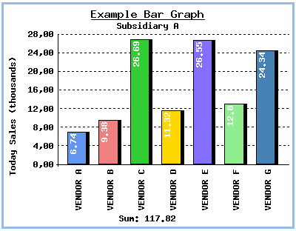
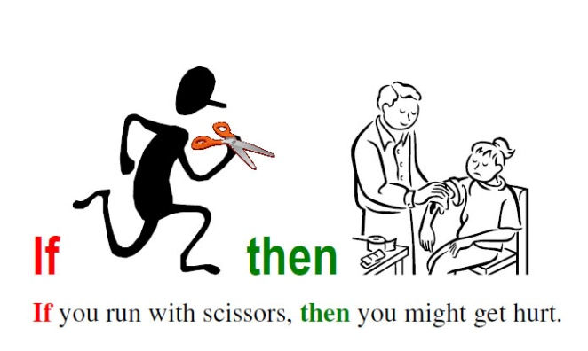
Logos – Logical Argument
Involves facts or research
Quoted authorities
Cause and Effect information
Analogies or comparisons
Common sense information
Shared values
Precedents

Slide 15
Examples of Logos
Lady Gaga was more popular than Justin Bieber in 2011 because Gaga's fan pages collected ten million more Facebook fans than Bieber's.
Cigarette smoke contains over 4,800 chemicals, 69 of which are known to cause cancer. Therefore, smoking causes cancer.
All men are mortal.
Socrates is a man.
Therefore, Socrates is mortal.

